Slide 1
Mini Project Ideas

Slide 2
MICROPROCESSOR CIRCUITS

Slide 3
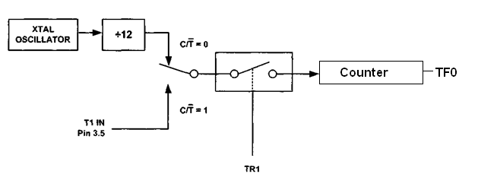
Timer Section of Microcontroller

Slide 4
DESIGN OF MEMORY CIRCUITS

Slide 5
Random Access Memory (RAM)
More efficient than registers for storing large amounts of data
Can read and write to RAM
Addressable memory
Can be synchronous (with clock) or asynchronous (no clock)
SRAM dimensions are:
  (number of words) x (bits per word) SRAM
Address is m bits, data is n bits
  2^{m} x n-bit RAM
Example: address is 5 bits, data is 8 bits
  32 x 8-bit RAM
Write
  Data_in and address are stable
  Assert write signal (then de-assert)
Read
  Address is stable
  Assert read signal
  Data_out is valid
data in (n)
RAM
data out (n)
address (m)
write
read

Slide 6
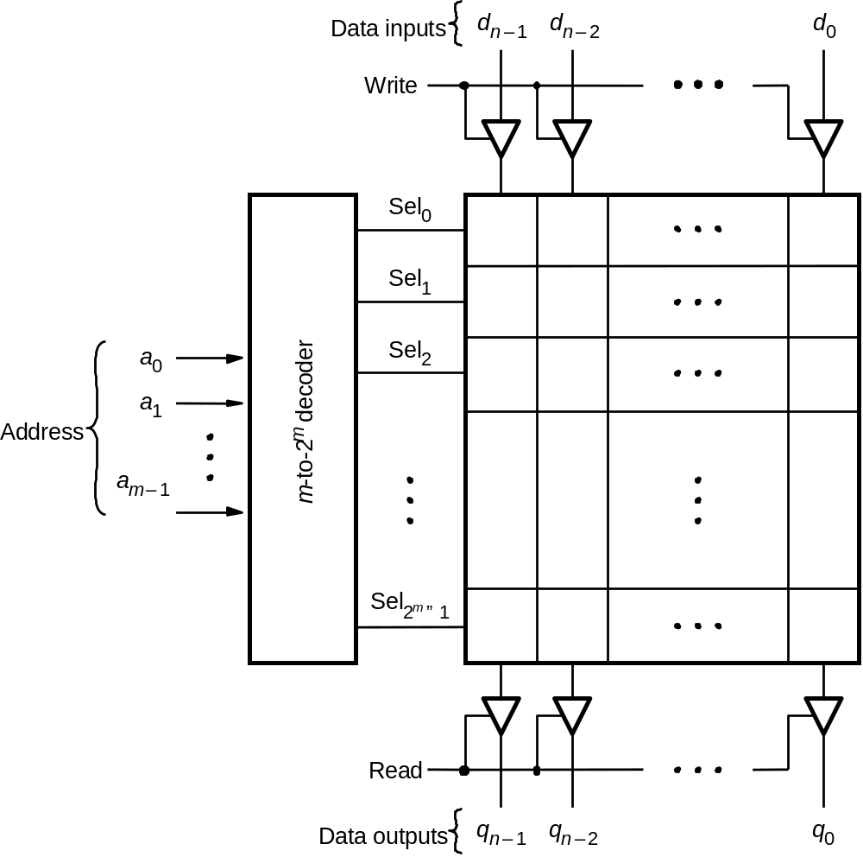
Random Access Memory (RAM)

Slide 7
Read Only Memory (ROM)
Similar to RAM except read only
Addressable memory
Can be synchronous (with clock) or asynchronous (no clock)
data in (n)
ROM
data out (n)
address (m)
read

Slide 8
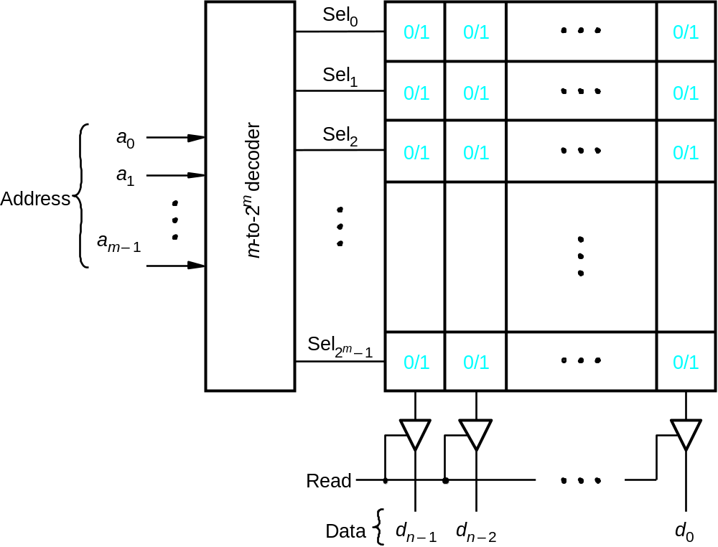
Read-Only Memory (ROM)

Slide 9
DATA ACQUISITION CONTROLLER

Slide 10
Data Acquisition Controller
External inputs
CONTROLLER
control signals
ADC
status signals
data output

Slide 11
WAVEFORM GENERATORS

Slide 12
Waveform GENERATORS
Waveform Outputs
CONTROLLER
control signals
DAC
status signals
data output

Slide 13
DISPLAY CONTROLLERS

Slide 14
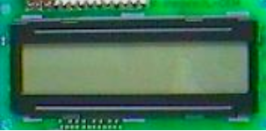
Display Controllers
Pinout
  8 data pins D7:D0
  RS: Data or Command
  Register Select
  R/W: Read or Write
  E: Enable (Latch data)
RS – Register Select
  RS = 0 → Command Register
  RS = 1 → Data Register
R/W = 0 → Write , R/W = 1 → Read
E – Enable
  Used to latch the data present on the data pins.
D0 – D7
  Bi-directional data/command pins.
  Alphanumeric characters are sent in ASCII format.
E
communications bus
R/W
Controller
RS
DB7–DB0
8
LCD Module

